Slide 1

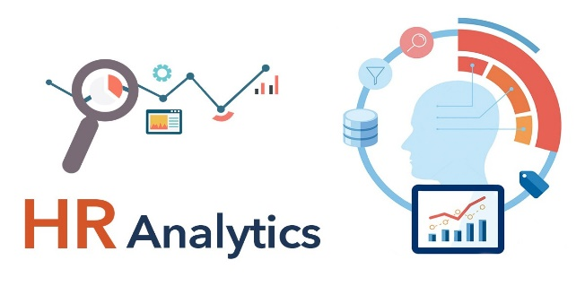
HR Analytics Project – Employee Retention Analysis
Group - 2

Slide 2



TEAM MEMBERS
SANDEEP GUPTA
SHAILESH KUMAR
SURYA PRATAP
PANIGRAHI
PRANAV PRAMOD NAIK
SHRUSHTI DEEPAK
SHINDE
ROHAN SAGAR SHINDE
SOUMYA SANTOSH
NAIK

Slide 3
🎯 Introduction & Objective
Title: Project Objective
Content:
📉Understand the trends and patterns behind employee attrition
🧩Identify factors impacting employee retention
💡Provide data-driven recommendations to improve employee retention and engagement

Slide 4
🖥️ Dashboard Overview
🧮 KPIs: Total Employees, Attrition Count, Active Workforce, Avg. Working Hours
🏢 Filtered views: Department, Age Bucket, Gender
📌 Built using Power BI with dynamic slicers and visuals

Slide 5
DASHBOARDS

Slide 6
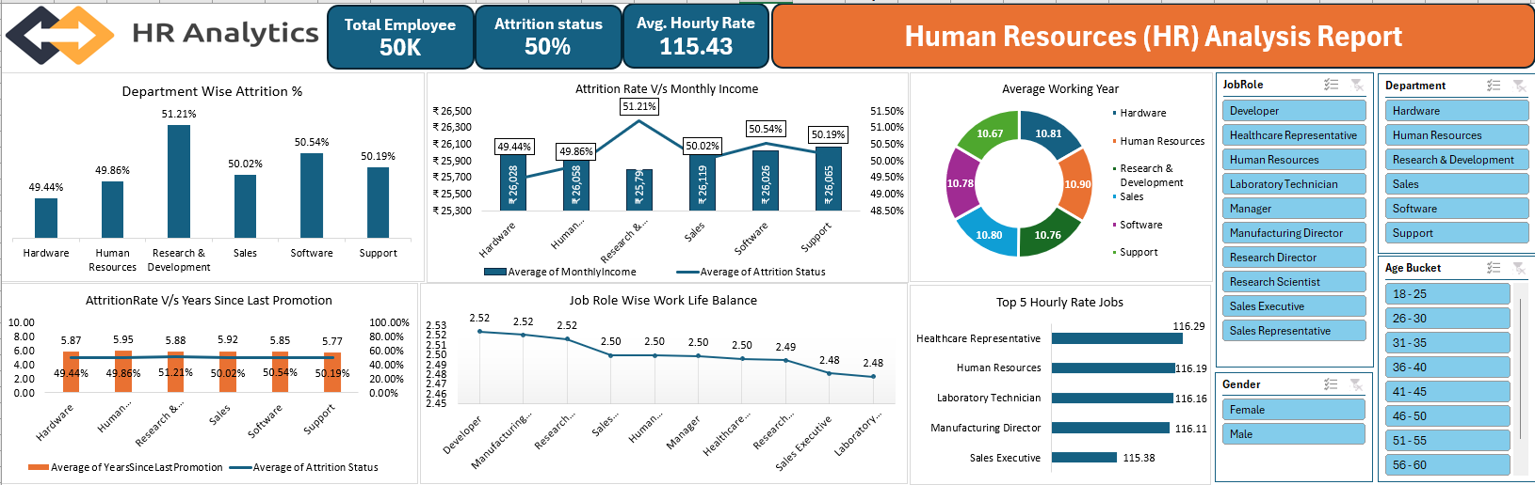
INITIAL DASHBOARD By EXCEL

Slide 7
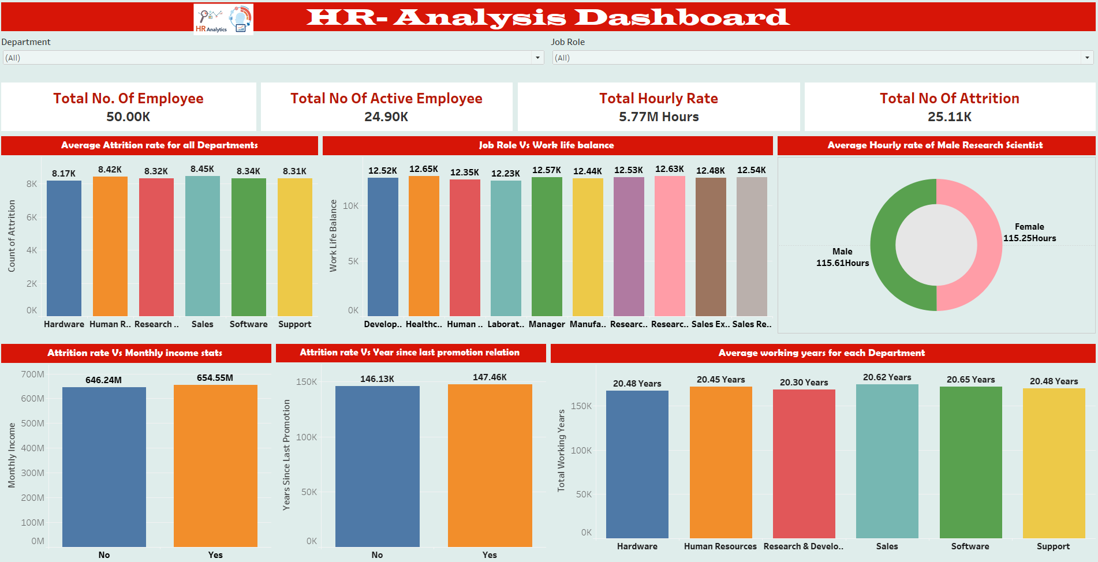
ADVANCED DASHBOARD By TABLEAU

Slide 8
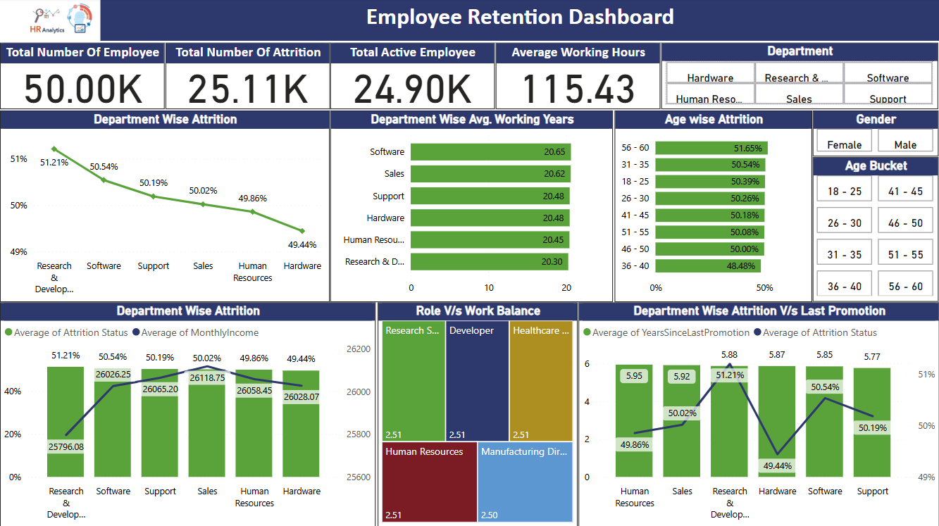
INTERACTIVE DASHBOARD By POWER Bi

Slide 9
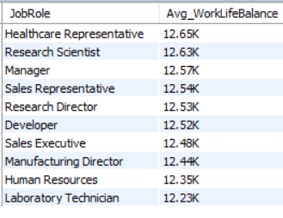
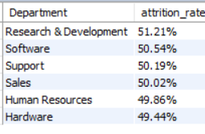
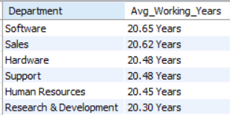



MYSQL

Slide 10
📌 Key Metrics at a Glance
👥 Total Employees: 50K
❌ Total Attrition: 25.11K (~50.2%)
✅ Active Employees: 24.90K
🕒 Average Working Hours: 115.43 hrs/month
🏆 Longest Serving Dept: Software (20.65 years)

Slide 11
Department-wise Attrition Analysis
🏢 Department-wise Attrition
🔼 Highest Attrition: Research & Development
(51.21%)
🔽 Lowest Attrition: Hardware (49.44%)
💰 Salary remains consistent, indicating other influencing factors

Slide 12
Age-wise Attrition Trends
👶👩🧓 Age-wise Attrition
📈 Highest in 56–60 age group (51.65%)
✅ Lowest in 36–40 age group (48.48%)
🔄 Middle age ranges (31–45) hover around 50.2%

Slide 13
Attrition vs Last Promotion
📉 Attrition vs Years Since Last Promotion
⏳ Longest since promotion: R&D (5.92 yrs) → highest attrition
💼 Hardware shows stability despite promotion delays
📊 Promotion delays are linked with higher exits in many departments

Slide 14
Role vs Work-Life Balance
⚖️ Role vs Work-Life Balance
🔁 Balance score consistent (~2.5) across all roles
⚠️ Indicates uniform dissatisfaction or unaddressed work-life policies
🟩 Treemap showing work-life balance by role

Slide 15
Challenges Faced & Solutions
🧱 Challenges & 💡 Solutions
📉 Incomplete Data (e.g., balance scores) ➤ Cleaned using Power Query & data assumptions
🔍 Unclear Relationship between variables ➤ Used combo charts to visualize trends
📛 Department Label Inconsistencies ➤ Standardized naming in Power BI data model

Slide 16
Achievements
🏅 Key Achievements
✔️ Designed fully interactive HR dashboard
🎯 Identified 4+ patterns in attrition trends
📈 Delivered department-level actionable insights
🧠 Used DAX, filters & Power Query for transformation

Slide 17
Recommendations
📌 Strategic Recommendations
🪜 Shorten promotion cycles in R&D & Support
🧘 Invest in work-life balance programs
🧓 Create retention strategies by age group
🧪 Design innovation incentives for R&D staff

Slide 18
Conclusion
📘 Conclusion
📉 Attrition is a pressing issue across age & roles
📊 Our dashboard identified key internal factors
🚀 Insights enable data-backed HR planning

Slide 19
THANK YOU

